Slide 1

Managing Storage Using
Partitions, LVM, and Stratis
By: Sean Twiehaus

Slide 2
About Me
System Administrator for several years
Saw the transition to Cloud and DevOps
‘Noped’ out to Software Development
Current Roles:
Tech Lead Software Engineer at Southwest Airlines
Adjunct Faculty at St. Charles Community College

Slide 3

This content was only tested on Red Hat Enterprise Linux 9.3

Slide 4
Partitions
Split Hard Drive into sections
Pro
Isolation
Prevent partition with root (/) from filling up!
Con
Inflexible
Must plan ahead!

Slide 5
Two Partition Types
MBR – Master Boot Record
GPT – GUID Partition Table

Slide 6
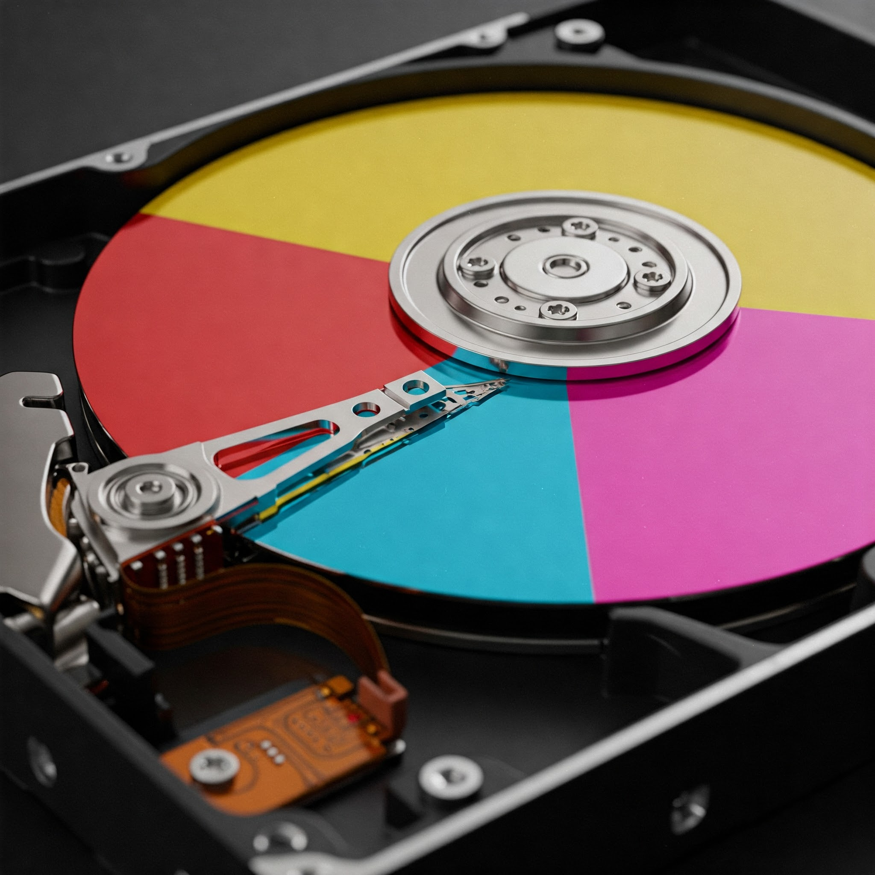
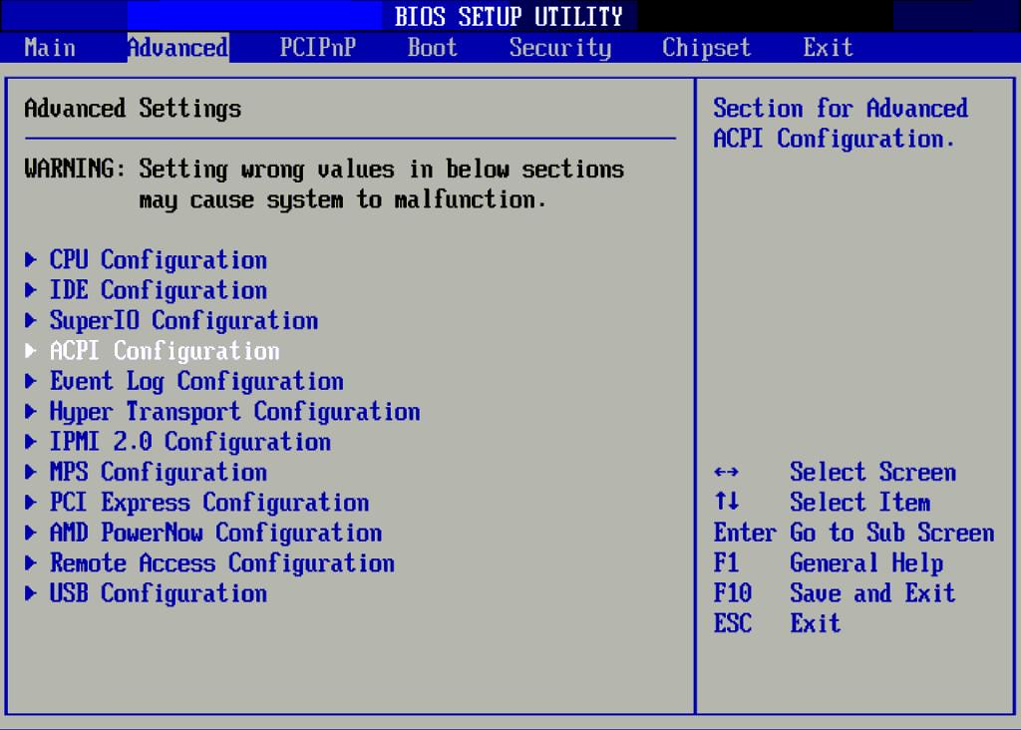
Master Boot Record (MBR)
MBR is an older partitioning scheme
Only four “primary” partitions.
Total disk size is limited to 2 TiB
An extended partition allows for more partitions to be created.
Single point of failure
Used with Basic Input/Output System (BIOS)
Notes:
The Master Boot Record (MBR) is the traditional method of partitioning hard drives. It allows only four primary partitions and limits the total size to 2 TiB. An extended partition can help create additional logical partitions. It's essential to understand MBR's role in the boot process, as it contains crucial information for starting the operating system.

Slide 7
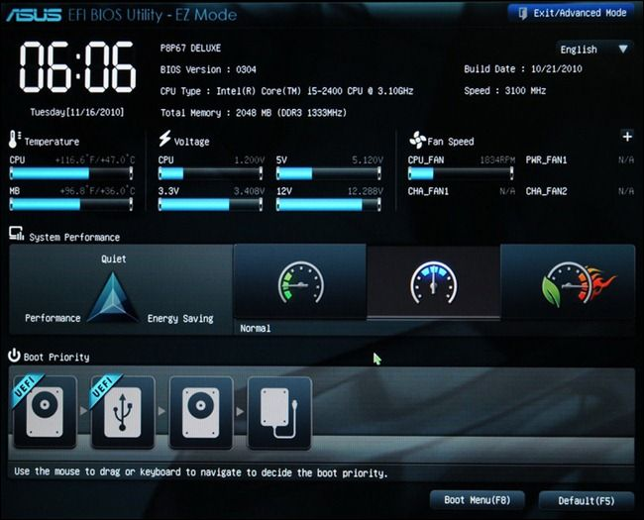
GUID Partition Table (GPT)
More Modern than MBR
Up to 128 partitions
Up to 8 ZiB drives
GUID - Globally Unique Identifier (128-bit)
Two copies of GPT for redundancy
Compatible with UEFI firmware
  Unified Extensible Firmware Interface
Notes:
The GUID Partition Table (GPT) is a more modern alternative to the Master Boot Record (MBR). With the capability to support up to 128 partitions and massive disk sizes of up to 8 ZiB, GPT is designed for larger storage devices. The term GUID refers to a 128-bit identifier that ensures unique identification for partitions, enhancing data integrity and offering redundancy in case of disk corruption.

Slide 8
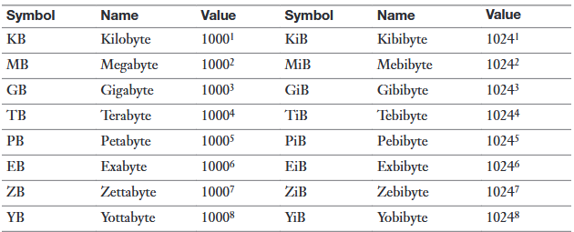
Disk Size Units

Slide 9
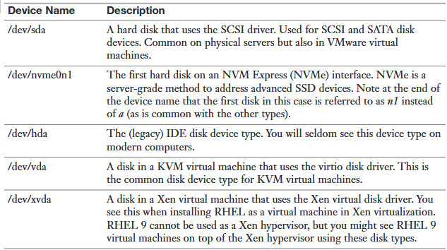
Common Device Names

Slide 10

Partitioning Components
'lsblk' command
'parted’ utility
Storage Devices '/dev/sd[a-z]*'
Notes:
In this slide, we discuss two essential tools for managing disk partitions on a Linux system. The 'lsblk' command provides a clear view of all block devices attached to the system, while 'parted' is a powerful utility for creating and managing partitions. Understanding the device naming convention, such as '/dev/sd[a-z]*', is crucial for effective disk management.

Slide 11
Create Five MBR Partitions on /dev/sdb
View storage devices
Inspect /dev/sdb
Create msdos disk label
Create five partitions
Verify the partitions

Slide 12
https://asciinema.org/a/702306

Slide 13


Slide 14

File Systems
Controls how files are stored on a storage device
Many choices
  EXT4, BTRFS, ZFS, XFS
Red Hat recommends XFS

Slide 15
XFS (eXtensible File System)
Journaling File System
Supports up to 1024 TiB Devices
XFS file systems can only grow, not shrink
EXT4 supports resizing in both directions

Slide 16
Create File Systems on /dev/sdb
Inspect /dev/sdb
Create XFS File System on /dev/sdb1
Create EXT4 File System on /dev/sdb2
Verify the file systems

Slide 17
https://asciinema.org/a/702307

Slide 19
Mount File System Temporarily
Mount command
Similar sytax as cp
mount /from /to

Slide 20
Mount File System automatically at Boot
/etc/fstab
F-Stab or FS-tab(le), you decide! 😆
Entries are translated to Systemd.Mount units

Slide 21
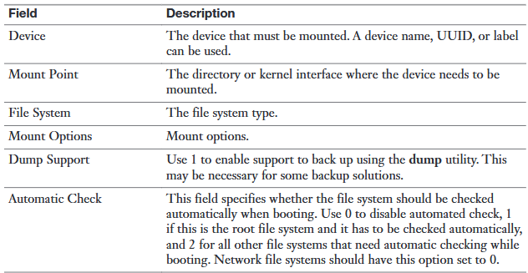
/etc/fstab fields

Slide 22
Mount /dev/sdb1 file system on /mnt/records
Inspect /dev/sdb
Temporarily mount /dev/sdb1 on /mnt/records
Verify temporary mount
Unmount /dev/sdb1
Persistently mount /dev/sdb1 on /mnt/records
Verify mount
Reboot and verify

Slide 23
https://asciinema.org/a/702308

Slide 25

Logical Volume Management (LVM)
Abstraction over storage devices
Provides flexibility
  Resize volumes without stopping applications

Slide 26
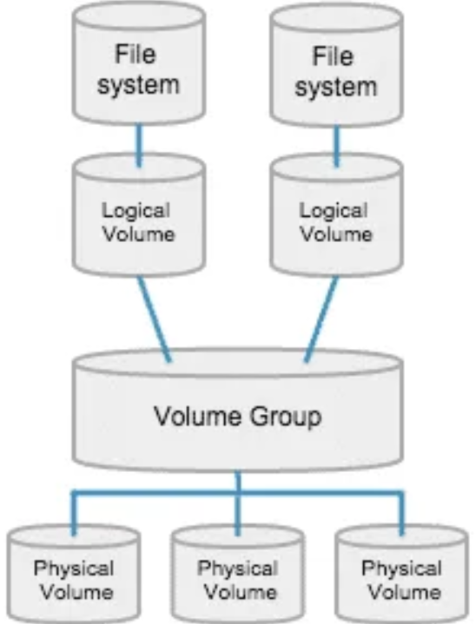
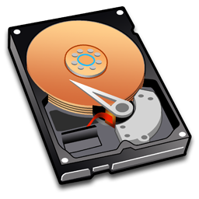
Layers
Physical Volumes
Volume Groups
Logical Volumes
/home
/

Slide 27
Create Logical Volume
XFS
Logical Volume (lv1)
/dev/sdc1 → Physical Volume
Physical Volume → Volume Group (vg1)
Volume Group → Logical Volume (lv1)
Mount Logical Volume
Volume Group (vg1)
Physical Volume
/dev/sdc1

Slide 28

LVM Components - Create
Physical Volume
pvcreate, pvs, pvdisplay, pvremove
Volume Group
vgcreate, vgs, vgdisplay, vgremove
Logical Volume
lvcreate, lvs, lvdisplay, lvremove

Slide 29
Create a Logical Volume
Identify and inspect a storage device
Create /dev/sdc1 partition to be used in LVM
Create a Physical Volume
Create a Volume Group
Create a Logical Volume
Locate the Logical Volume
Create a file system on /dev/vg1/lv1
Mount file system to /mnt/evidence
Verify the file system

Slide 30
https://asciinema.org/a/702649

Slide 32
Extend Logical Volume
XFS
Logical Volume (lv1)
/dev/sdd1 → Physical Volume
Physical Volume → Volume Group (vg1)
Expand Logical Volume (lv1)
Volume Group (vg1)
Physical Volume
Physical Volume
/dev/sdc1
/dev/sdd1

Slide 33
LVM Components - Extend
Volume Group
vgextend
Logical Volume
lvextend
File System
xfs_growfs

Slide 34
Extend Logical Volume lv1
Inspect lv1 Logical Volume
Identify and inspect a storage device
Create /dev/sdd1 partition to be used in LVM
Create a Physical Volume
Extend the vg1 Volume Group
Extend the lv1 Logical Volume
Extend the file system
Verify the file system

Slide 35
https://asciinema.org/a/702661

Slide 37
Stratis
Brand New
Abstraction over storage devices
Advanced Features out of the box
  Thin provisioning
  Snapshots
  Encryption
XFS Only

Slide 38
Create Stratis File System
XFS File System
XFS File System
Create Storage Pool from block devices
Create file systems from the pool
  Thin provisioned
Pool
/dev/sdc
/dev/sdd

Slide 39
Stratis Components
Packages
stratisd – Systemd service
Stratis-cli – Command line interface
Command
stratis [pool | filesystem | blockdev | …]

Slide 40
Create a File System on Stratis
Install the statis packages
Start and enable the stratisd service
Identify and inspect a storage device
Inspect stratus-cli
Create stratis pool
Create stratis file system
Locate file system
Mount file system
Inspect thin provisioning

Slide 41
https://asciinema.org/a/702866

Slide 43
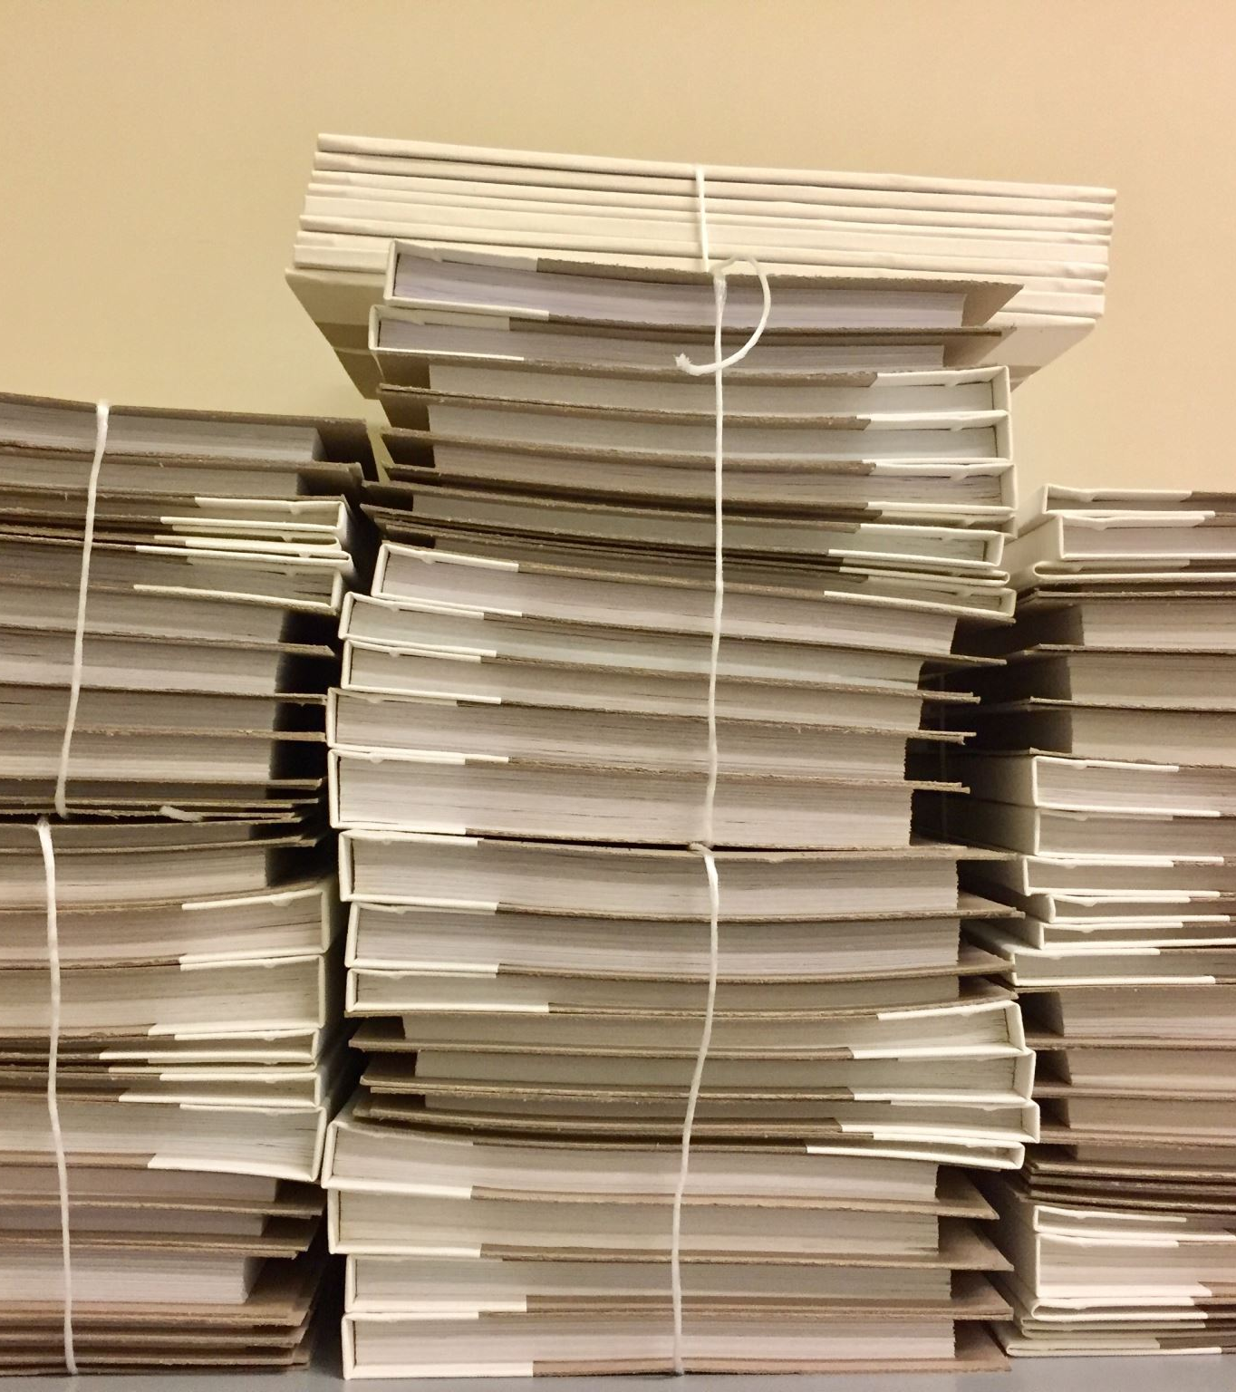
Stratis Snapshots
Take a “moment in time” backup
Easily revert or rollback changes

Slide 44
Restore data using a stratis snapshot
Take a snapshot of the fs1 file system
Catastrophically destroy data
Mount the snapshot
Restore data from snapshot
Unmount the snapshot
Destroy the snapshot

Slide 45
https://asciinema.org/a/7###

